Slide 1


Korea’s Green Growth Vision June 2009 Ki Jong WOO Secretary General
Presidential Committee on Green Growth

Slide 2
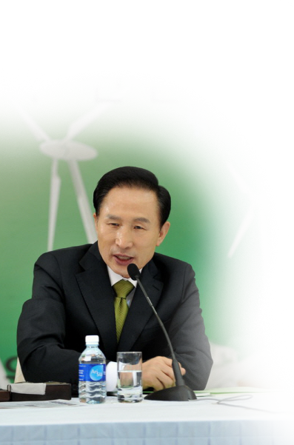
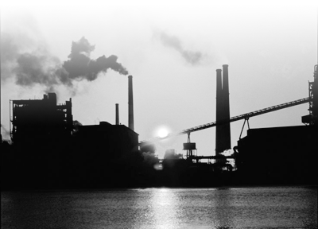

Presidential VISION – Low Carbon Green Growth
Creating New 60 years (announcement of a new national vision in the 60th anniversary of the founding of the Republic on August 15th 2008)
Next 60 years
Last 60 years
Green growth
Economic growth
More than just an environmental policy - a new paradigm of progress - changing people’s behavior and way of thinking

Slide 3
What is Green Growth?
What do we mean by Green Growth
’as we go green – we get money & jobs”
<Elements of Green Growth>
Green
Technology as
a new growth
engine
green energy
paradigm
Improvement
in quality
of life
Contribution
to the global
community

Slide 4
How can we achieve Green Growth?
Technology
Policy tool
(regulation &
incentive)
Change in
life-style

Slide 5
Why is Korea striving for Green Growth?
Climate Affect
average temperature rise 1.7℃ (2 times more than world average)
Energy security vulnerability
“New path
is needed”
140 billion USD energy bill
Economic slow-down
growth rate declining since the Asian economic crisis in late 1990s
growth without rise in employment

Slide 6
The Logic
High
GER
JAP
UK
CAN
SPA
USA
AUS
FRA
EUR
KOR
ITA
ARG
POL
BRA
Capacity to Adapt
ZAR
TUR
IND
MEX
IDN
CHN
RUS
SAU
PAK
UKR
IRA
Low
Environmental Stress and Vulnerability
High
Source : ESI, Morgan Stanley Research

Slide 7
The Logic
S
W
Capacity to adapt  top leadership
Energy dependent industry
Opportunity as a new growth engine
Internal & external uncertainty
O
T

Slide 8
Features of the Green Growth in Korea
Strong Green Leadership
Presidential Committee on Green Growth
Fast integration of the Vision in all sectors
meaningful partnership with private council (business, financial sector, technology experts etc.)
Strong industrial base in relevant areas
large competent players
Turning it into “real actions”

Slide 9
Actions
Sustained Drive
key role for the Presidential Committee on Green Growth
Legal Framework
early ratification of the Basic Act on Green Growth
National midterm GHG reduction target
- set this year -
inherits the spirit of the “Economic
Development Plan” in the 60~80s * 5 year implementation plans
- new “green saemauel movement”
Strategy Plan
Green Budget
Green New Deal - Re-orientation of private-public finance
toward green (policy, R&D, SOC)

Slide 10
Basic Act on Low Carbon Green Growth
Composition
7 chapters and 65 articles
a basic act – it has priority over all relevant laws regarding Green Growth
Key provisions
legal ground for the Presidential Committee on Green Growth and mandates the committee
to develop a national strategy for Green Growth.
2) mandates the government to foster and support green economy, green industry, and the
transformation of conventional industry.
foster financing for green technology R&D and green investment, as well as, mandates
to promote environment friendly tax reform.
mandates government to set concrete targets for GHG emission reduction, energy saving,
energy security, and renewable energy supply.
5) mandates for mandatory reporting of GHG emission for businesses. Provides the legal
framework to introduce cap & trade system in Korea.
6) articles on environment-friendly land use, green building, low carbon transportation,
green consumption and production, and other issues related to sustainable development.

Slide 11
Basic Act on Low Carbon Green Growth
Composition
7 chapters and 65 articles
a basic act – it has priority over all relevant laws regarding Green Growth
Key provisions
legal ground for the Presidential Committee on Green Growth and mandates the committee
to develop a national strategy for Green Growth.
2) mandates the government to foster and support green economy, green industry, and the
transformation of conventional industry.
foster financing for green technology R&D and green investment, as well as, mandates
to promote environment friendly tax reform.
mandates government to set concrete targets for GHG emission reduction, energy saving,
energy security, and renewable energy supply.
5) mandates for mandatory reporting of GHG emission for businesses. Provides the legal
framework to introduce cap & trade system in Korea.
6) articles on environment-friendly land use, green building, low carbon transportation,
green consumption and production, and other issues related to sustainable development.
Notes:
11

Slide 12

National Strategy for Green Growth
Current Status
a multi-agency + research institute participating project
strategy and 5 year implementation plan being developed (target date July 2009)
Key Framework
Vision
A Model Green Nation - through creating virtuous harmony of environment & economy
Low Carbon Society
And Energy Security
New Engine
for Growth
Enhanced Quality of Life & Int’l Leadership
Objectives
Build Low Carbon
Society
Greater Energy Security
Addressing Climate
Change
R&D for Green Tech.
Foster Green Industry
Greening the Industry
Lay the Foundation
for Green Economy
Green Transportation &
Land Management
Green Life-style
International leadership
10 Key
Agenda

Slide 13
Green New Deal
Background & Key projects
Green New Deal announced on Jan. 2009 - 9 key projects and supporting projects
focused on job creation as well as building the foundation for low carbon economy transition
Project Name |  | Budget (billion KRW) |  |  | Job Creation (# of jobs)
 |  | 2009 | ~ 2012 | total | 2009 | ~ 2012 | Total
total sum |  | 4,363 | 45,687 | 50,049 | 93,360 | 863,060 | 956,420
K E Y P R O J E C T S | 4 Major River Revitalization | 488 | 13,990 | 14,478 | 7,000 | 192,960 | 199,960
 | Green Transportation | 1,835 | 7,819 | 9,654 | 25,042 | 113,025 | 138,067
 | Integrated Territory Management | 25 | 347 | 372 | 816 | 2,304 | 3,120
 | Water Resource Catchment | 185 | 758 | 942 | 3,063 | 13,069 | 16,132
 | Green Car & Clean Energy | 321 | 1,732 | 2,053 | 1,643 | 12,705 | 14,348
 | Waste Resource Reuse | 51 | 879 | 930 | 2,377 | 13,819 | 16,196
 | Forestry | 313 | 2,104 | 2,417 | 22,498 | 148,204 | 170,702
 | Green Home, Green School | - | 8,050 | 8,050 | - | 133,630 | 133,630
 | Ecological River | 5 | 479 | 484 | 393 | 10,396 | 10,789
Support Projects |  | 1,140 | 9,530 | 10,670 | 30,528 | 262,038 | 141,639

Slide 14
New Engine for Growth
Background
Selected 3 key sectors (17 areas) as the new engine for economic growth (Jan 2009)
key sectors: green technology, advanced convergent technology, high-value service
Implementation Plan : 6.7 trillion won investment on 79 measures to promote green technology
development (May 2009)
Areas | No. of Measures | Budget (trillion KRW) | Key Measures
Total | 79 | 6.7
Renewable Energy | 19 | 2.8 | R&D on silicon photovoltaic technology Introduction of renewable portfolio standard (RPS)
Low Carbon Energy | 8 | 0.9 | R&D on CCS support on Korean nuclear power development
Advanced Water Treatment | 13 | 0.6 | commercialization of advanced membrane tech. revision of legislations to promote wastewater reuse
LED Application | 8 | 0.4 | R&D on LED parts pilot project on LED use
Green Transportation System | 16 | 1.0 | Green Car : building networks for parts development Intelligent transportation system
High-Tech Green City | 15 | 1.0 | Environment-friendly buildings U-City development
Notes:
14

Slide 15

Challenges Ahead
Continued support from the public
the key to success of Green Growth
Support from business community
meeting its needs to adapt & change
setting a price on target
: emission trading & carbon tax

Slide 16

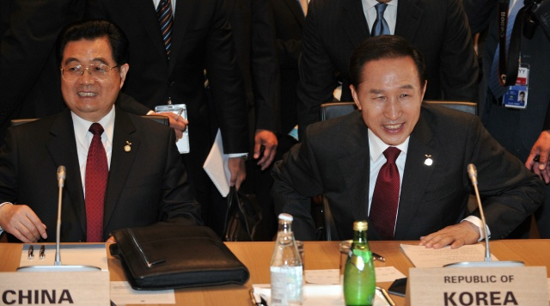
We want to share this vision with our neighbors
East Asia Climate Partnership
announced at G8 Extended Summit Meeting (Toyako Japan 2008)
200 million USD for 5 years (2008 ~ 2012)

Slide 17



What can Korea bring to the partnership
The formula for finding a win-win strategy
Fresh memory of poverty & development
Wants to share a common vision with our neighbors

Slide 18

Areas of Cooperation
Policy Dialogue : East Asia Climate Forum (May 29, 2009)
Finding the roadmap to Green Growth in Asia
Low Carbon Green Growth Expo
Promoting technology development and technology transfer
Climate Solutions (ODA grants)

Slide 19
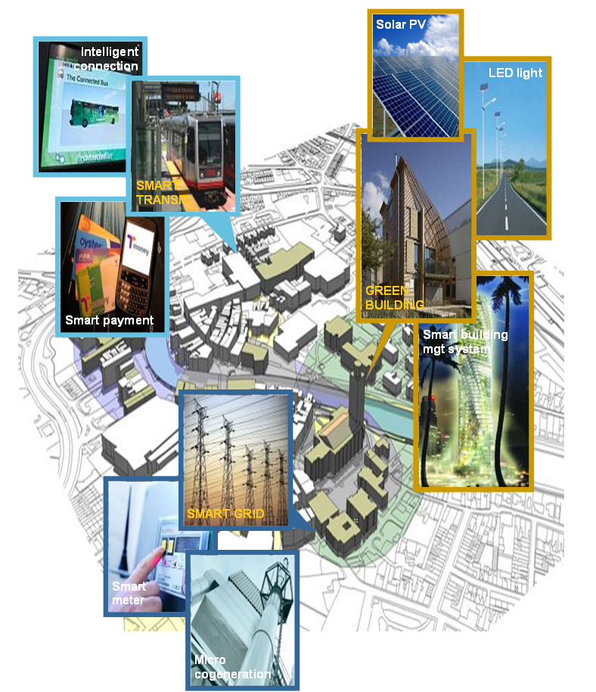
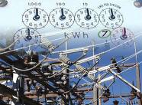
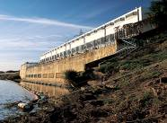
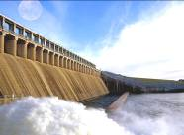
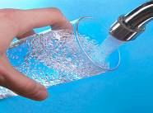
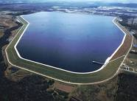
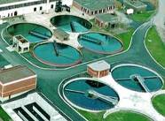
Areas of Cooperation
Integrated Water Management
Building Smart Low-Carbon Cities
EARLY WARNING SYSTEM
WATER PURIFICATION
DAMS
WATER SUPPLY AND DRAINAGE
RESERVOIR
SEWAGE TREATMENT

Slide 20

Green Growth is not an option but, the only option
Green Growth is not plan B, it’s the Plan A
It is the strategy of change that jumps over the chasm
and it is a concept of creativity that opens all possibilities

